Slide 2
Motivation & Engagement in Mathematics and Science Inquiry
Dr. Carl J. Wenning
Department of Physics

Slide 3
What is Inquiry?
Inquiry is not:
teachers asking lots of questions.
students looking up answers to teacher questions.
students finding out what others have learned.
Inquiry is helping students to construct knowledge on the basis of their own experiences.

Slide 4
Why Use Inquiry in Teaching?
Science and mathematics consist of both product and process.
When students learn only the products of science and mathematics:
they are learning history, and
are not getting a proper view.
When students fail to learn the processes they are not learning how to use science and mathematical reasoning. Neither are they learning how to use critical thinking.

Slide 5
Thinking in Science & Math
Major types of thinking (Dewey & Betts):
Chance or idle thinking (based on emotions or intuition)
Assimilative thinking (critically reviewing the value of information prior to acceptance)
Deliberative thinking (making judgments about beliefs or conclusions that are based on evidence)
Students must be “engaged” if they are to learn higher-level thinking skills.

Slide 6
Critical Thinking Skills
Identify and clarify problems
Ask appropriate questions
Analyze situations
Distinguish between fact and inference
Evaluate relevant information and outcomes
Make predictions
Identify and evaluate assumptions
Draw conclusions based on evidence
Assess one’s own thinking

Slide 7
Science Reasoning Skills
Raise questions on the basis of observations
Create an observational/experimental protocol
Gather and interpret data from observation and/or experiment
Draw evidence-based conclusions
Think carefully about assumptions, conclusions, implications, and consequences
Test your conclusions or predictions
Compare and defend scientific claims

Slide 8
Knowledge vs. Faith
Knowledge is a substantiated belief.
If we claim to know something, we must have evidence.
Do we know or merely believe the following?
Earth is spherical (oblate spheroid)
Earth orbits the sun annually
These are “articles of faith” for many of us.
There are many ways of knowing but most rely upon authority.

Slide 9
The Good of Math & Science
Inductive reasoning – We make broad generalizations from specific instances.
Deductive reasoning – We make specific predictions based upon a general rule.
Abductive reasoning – We use observations to generate a hypothesis in an attempt to account for these observations.

Slide 10
Engagement with Thinking
Engagement means to actively use one’s mind.
Engagement requires motivation such as interest or a need.
Inquiry-oriented teaching encourages engagement.
Teaching by telling encourages uncritical acceptance of “facts”.

Slide 11
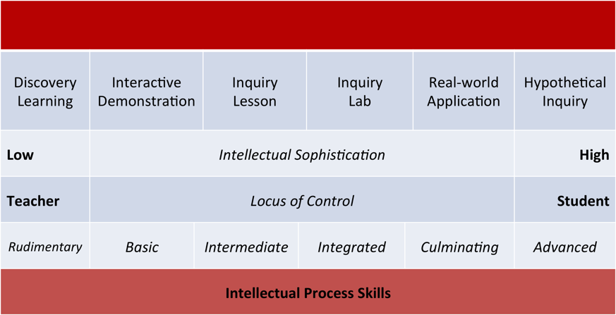
Engaging Students: LoI

Slide 12
Science Reasoning Skills (Low)
Rudimentary (Discovery)
Basic (Demonstrations)
Classifying
Conceptualizing
Concluding
Contextualizing
Ordering
Generalizing
Problematizing
Estimating
Explaining
Predicting
Using conditional thinking

Slide 13
Science Reasoning Skills (Med)
Intermediate (Lessons)
Integrated (Inquiry Labs)
Applying information
Describing relationships
Making simple sense of quantifiable data
Using combinatorial thinking
Using correlational thinking
Defining a problem
Defining a system
Designing and conducting a controlled experiment
Interpreting quantifiable data to establish a law

Slide 14
Science Reasoning Skills (High)
Culminating (Real-world)
Advanced (Hypo Inquiry)
Using causal reasoning to distinguish co-incidence and correlation from cause & effect
Using data and math to solve real-world problems
Using proportional reasoning to make predictions
Assessing answers to problems
Generating predictions using deduction
Generating and evaluating analogies
Thinking to assimilate concepts
Thinking deliberatively
Using probabilistic thinking.

Slide 15
Active Learning
Good worksheets with Think-Pair-Share
Whiteboarding and Socratic dialogues
Reciprocal reading and listening
Question preparation and student reviews
Concept mapping (CMapTools)
Simulations using technology.

Slide 16
La Motivación en Matemáticas
Si n! = n(n-1)…(2)(1),
entonces, ¿qué es 0! ?
--------------------
n! = n(n-1)…(2)(1)
n!/n = (n-1)…(2)(1)
n!/n = (n-1)!
Dejar n = 1
1!/1 = (1-1)!
1 = 0!

Slide 17
La Motivación en Ciencia
Está girando la Tierra o no?
¿Cómo sabes (o usted simplemente cree)?
Tenga en cuenta estas pruebas contra rotación:
No podemos sentir el movimiento de la Tierra.
No experimentamos vientos del este.
La Tierra no está perdiendo sus océanos.
Cosas lanzados en el aire no se quedan atrás.

Slide 18
Resistance to Inquiry
This resistance occurs in teachers, parents, administrators, students…
Students would rather be told what they need to know rather than work it out.
Classroom climate setting:
You can learn with understanding.
You can better remember what you learn.
You can apply knowledge to new situations.
You can learn to solve your problems and achieve your goals.

Slide 19
Teaching High School Physics
Book availability:
Amazon.com (for Kindle Reader)
Google Play Books (for browser)

